Slide 1
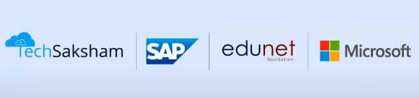
Ai Resume Screening & Candidate Ranking System
By
K . Abilash chary
abilashchary777@gmail.com
Guide
Saomya sri

Slide 2
Ai Resume Screening & Candidate Ranking System
Course Outline
Problem Statement
Proposed Solution
Software Requirement
System Architecture
Project Plan
Video of the Project
Future Scope
Conclusion

Slide 3
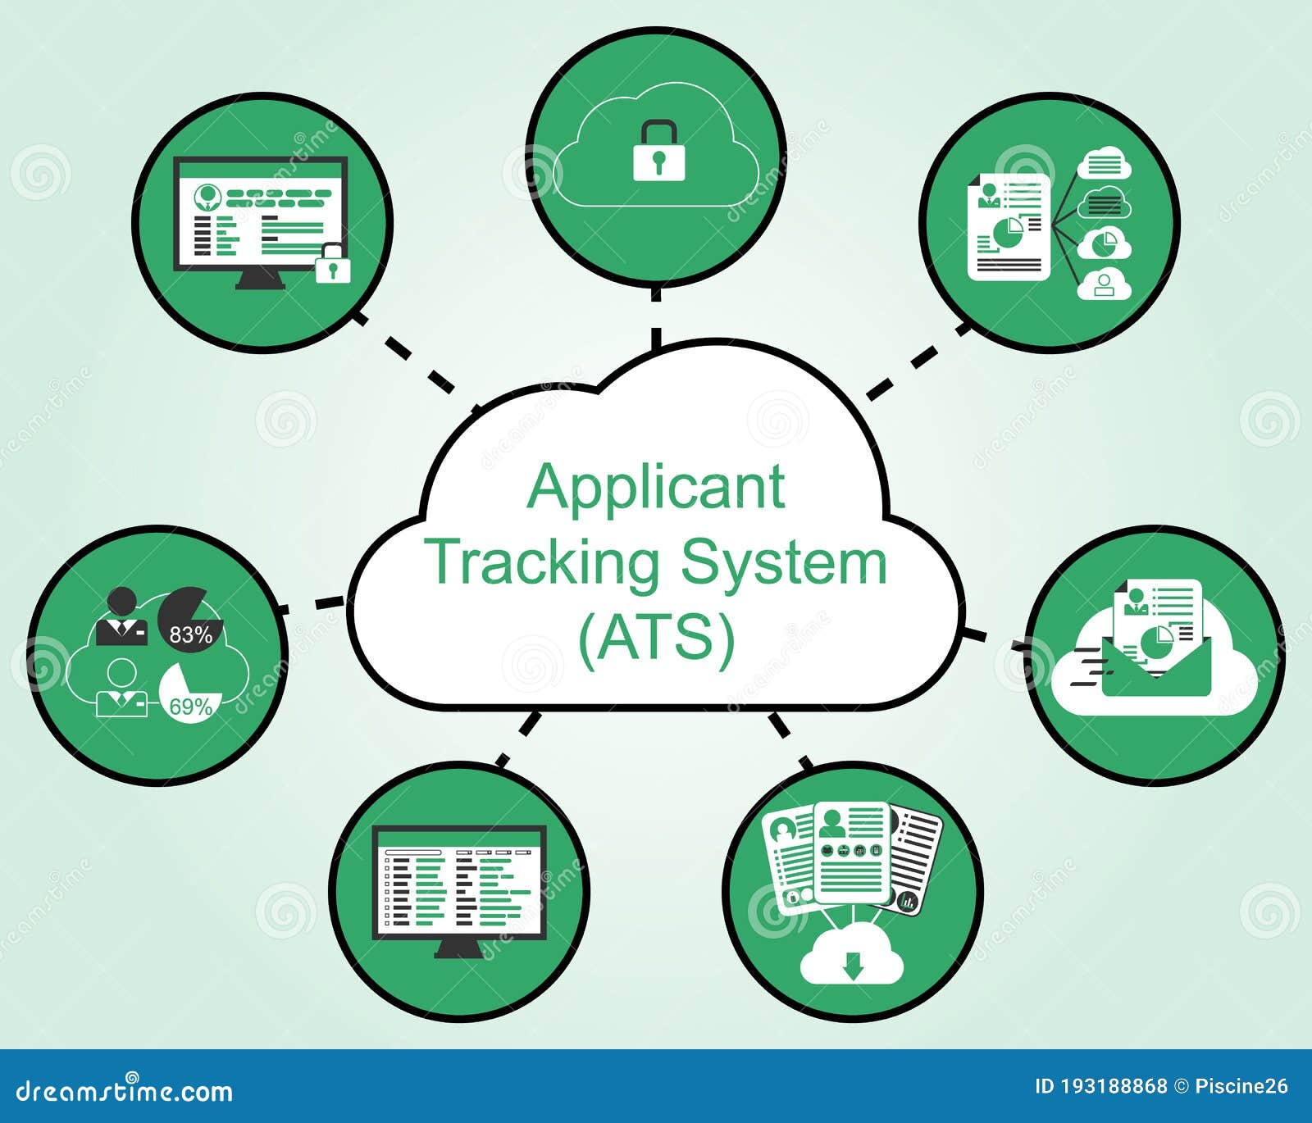
Ai Resume Screening & Candidate Ranking System
Problem Statement
The problem statement revolves around the concept of an "AI Resume Screening & Candidate Ranking System." It addresses the challenge of efficiently handling a large volume of job applications while ensuring an objective and accurate evaluation of candidates. Traditional recruitment methods often involve significant time, effort, and potential bias in manually reviewing resumes and assessing candidates. By leveraging artificial intelligence, such a system automates these processes, enabling recruiters to screen resumes based on predefined criteria and rank candidates more effectively. This innovation reduces human error, accelerates decision-making, and improves the overall recruitment experience for both employers and job seekers.

Slide 4
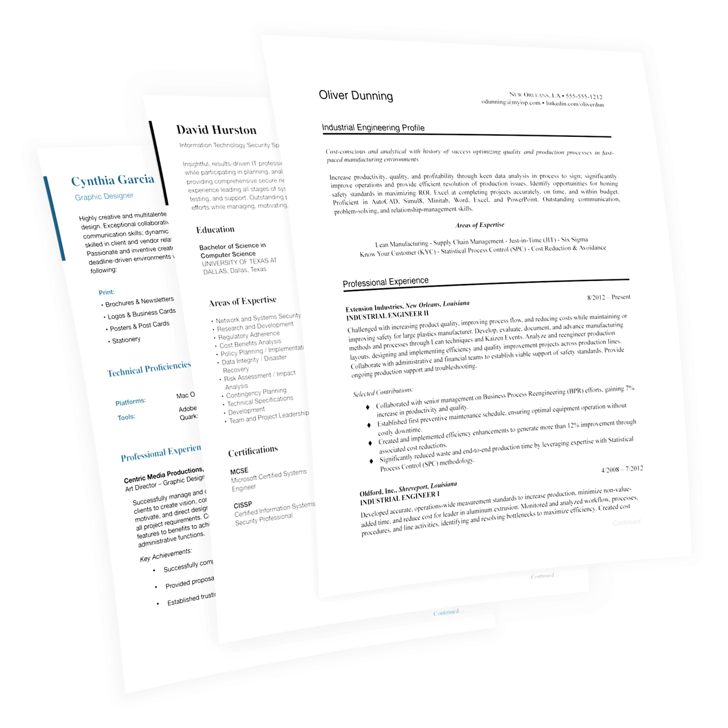
Ai Resume Screening & Candidate Ranking System
Proposed Solution
The proposed solution involves developing an AI-powered Resume Screening & Candidate Ranking System to address recruitment challenges. This system will utilize advanced algorithms to automate the process of reviewing resumes, ensuring a consistent evaluation based on predefined criteria like skills, experience, and qualifications. It will rank candidates objectively, prioritizing those who best match the job requirements. The tool can integrate natural language processing (NLP) to extract relevant information from resumes and machine learning models to adapt and improve its accuracy over time. By doing so, the system minimizes human bias, streamlines recruitment workflows, and accelerates the hiring process, ultimately enhancing the recruitment experience for employers and candidates alike.

Slide 5


Ai Resume Screening & Candidate Ranking System
Software Requirements
Frontend
Backend
Frameworks:
Sklearn / NLTK / Spacy
Deployment:
Deployment using Streamlit cloud.

Slide 6
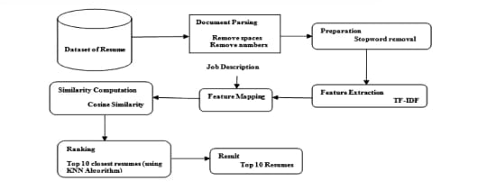
Ai Resume Screening & Candidate Ranking System
System Architecture

Slide 7
Ai Resume Screening & Candidate Ranking System
Project Plan
Phase 1:
1.Understand Objective & Requirements
2. Collect Relevant Data
*Phase 2:
3. Clean Data and Check for Errors
4. Check the Similarity Between the
Documents
5. Develop a Web Application Using
Streamlit
*Phase 3:
6. Deploy the Application to Stream Cloud
7. Prepare Documentation of the Project with Presentation
8. Submit on LMS

Slide 8
Ai Resume Screening & Candidate Ranking System
Video of the Project

Slide 9
Ai Resume Screening & Candidate Ranking System
FUTURE SCOPE
Enhanced Accuracy with Advanced AI Models: Future systems could integrate sophisticated AI models
like BERT or GPT to improve contextual understanding of resumes and job descriptions, leading to more
accurate candidate matching.
Bias Reduction: By refining algorithms, these systems can help minimize unconscious bias in hiring,
promoting diversity and inclusion in the workplace.
Multi-Language Support: Expanding capabilities to analyze resumes in multiple languages will make these
systems more accessible to global audiences.
Skill Gap Analysis: AI could identify skill gaps in candidates and suggest personalized training programs to
bridge those gaps, benefiting both employers and job seekers.
Integration with HR Tools: Seamless integration with existing HR management systems could streamline
the entire recruitment process, from screening to onboarding.
Interactive Dashboards: Future systems might include data visualization tools to provide insights into
candidate skills, experience, and market trends.
Real-Time Updates: AI systems could offer real-time updates on candidate rankings as new resumes are
submitted or job descriptions are modified

Slide 10
Ai Resume Screening & Candidate Ranking System
CONCLUSION
AI-driven resume screening and candidate ranking systems are poised to transform the recruitment landscape. Their future scope includes enhanced accuracy, bias reduction, multilingual capabilities, skill gap analysis, HR tool integration, and real-time updates. These advancements aim to streamline hiring processes, promote diversity, and optimize workforce management for organizations globally. The possibilities are endless as technology continues to evolve.

Slide 11
THANK YOU

